Slide 1
Cloud Computing And Intelligent Information Processing Key Laboratory
Decision Tree & Python
Ying Joy
Cloud Computing And Intelligent Information Processing Key Laboratory
December 13, 2017
yzk.1314@outlook.com

Slide 2
Outline
What is decision tree?
How to generate a decision tree?
CART & ID3 & C4.5
Pruning
Continuous and missing values
ID3 & Python

Slide 3
Outline
What is decision tree?
How to generate a decision tree?
CART & ID3 & C4.5
Pruning
Continuous and missing values
ID3 & Python

Slide 4
What is decision tree?
Cloud Computing And Intelligent Information Processing Key Laboratory
Outside Playing Dataset
Outlook | Temperature | Humidity | Windy | Play
sunny | 85 | 85 | FALSE | Don't Play
sunny | 80 | 90 | TRUE | Don't Play
overcast | 83 | 78 | FALSE | Play
rain | 70 | 96 | FALSE | Play
rain | 68 | 80 | FALSE | Play
rain | 65 | 70 | TRUE | Don't Play
overcast | 64 | 65 | TRUE | Play
sunny | 72 | 95 | FALSE | Dont Play
sunny | 69 | 70 | FALSE | Play
rain | 75 | 80 | FALSE | Play
sunny | 75 | 70 | TRUE | Play
overcast | 72 | 90 | TRUE | Play
overcast | 81 | 75 | FALSE | Play
rain | 71 | 80 | TRUE | Don't Play

Slide 5
What is decision tree?
Cloud Computing And Intelligent Information Processing Key Laboratory
What Is Decision Tree?
A decision tree is a decision support tool that uses a tree-like graph or model of decisions and their possible consequences, including chance event outcomes, resource costs, and utility. It is one way to display an algorithm that only contains conditional control statements(like if-else).

Slide 6
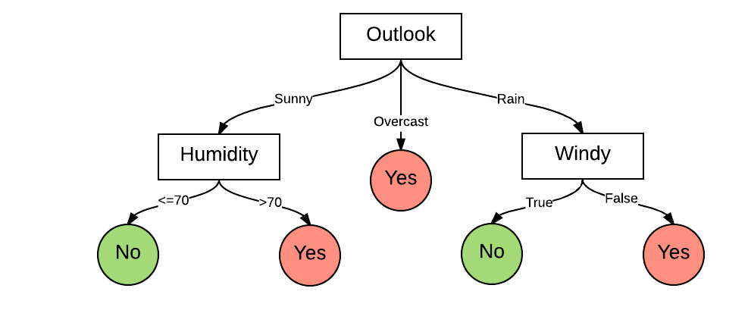
What is decision tree?
Cloud Computing And Intelligent Information Processing Key Laboratory
What Is Decision Tree?
Dataset
Decision Tree

Slide 7
Outline
What is decision tree?
How to generate a decision tree?
CART & ID3 & C4.5
Pruning
Continuous and missing values
ID3 & Python

Slide 8
What is decision tree?
Cloud Computing And Intelligent Information Processing Key Laboratory
Outside Playing Dataset
Outlook | Temperature | Humidity | Windy | Play
sunny | 85 | 85 | FALSE | Don't Play
sunny | 80 | 90 | TRUE | Don't Play
overcast | 83 | 78 | FALSE | Play
rain | 70 | 96 | FALSE | Play
rain | 68 | 80 | FALSE | Play
rain | 65 | 70 | TRUE | Don't Play
overcast | 64 | 65 | TRUE | Play
sunny | 72 | 95 | FALSE | Dont Play
sunny | 69 | 70 | FALSE | Play
rain | 75 | 80 | FALSE | Play
sunny | 75 | 70 | TRUE | Play
overcast | 72 | 90 | TRUE | Play
overcast | 81 | 75 | FALSE | Play
rain | 71 | 80 | TRUE | Don't Play

Slide 9
How to generate a decision tree?
Cloud Computing And Intelligent Information Processing Key Laboratory
Outside Playing Decision Tree
switch(outlook):
case 'Sunny':
if humidity < = 70:
return No
return Yes
break;
case 'Overcast':
return Yes
break;
case 'Rain':
if windy is True:
return No
return Yes
break;
Not consider temperature

Slide 10
How to generate a decision tree?
Cloud Computing And Intelligent Information Processing Key Laboratory
Algorithm
function DecisionTree(data )
if termination criteria met:
return base hypothesis
else:
1. Learn branching criteria
2. Split to parts
3. Build sub-tree
4. return
Termination Criteria
Branching Criteria
???
ataset

Slide 11
Outline
What is decision tree?
How to generate a decision tree?
CART & ID3 & C4.5
Pruning
Continuous and missing values
ID3 & Python

Slide 12
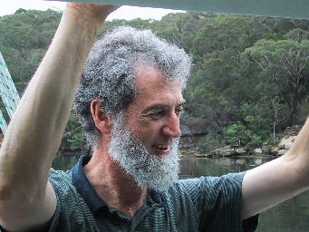
CART & ID3 & C4.5
Cloud Computing And Intelligent Information Processing Key Laboratory
TimeLine
Quinlan, J. R. C4.5: Programs for Machine Learning. Morgan Kaufmann Publishers, 1993.
C4.5
CART
1986
1984
1993
Breiman, Leo; Friedman, J. H.; Olshen, R. A.; Stone, C. J. (1984). Classification and regression trees. Monterey, CA: Wadsworth & Brooks/Cole Advanced Books & Software. ISBN 978-0-412-04841-8.
ID3
Quinlan, J. R. 1986. Induction of Decision Trees. Mach. Learn. 1, 1 (Mar. 1986), 81–106

Slide 13
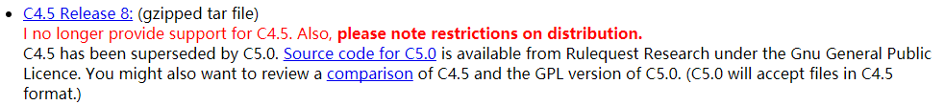
CART & ID3 & C4.5
Cloud Computing And Intelligent Information Processing Key Laboratory
C5.0
C4.5
http://www.rulequest.com/Personal/

Slide 14
CART & ID3 & C4.5
Cloud Computing And Intelligent Information Processing Key Laboratory
Symbol Description
Symbol | Description
 | dataset
 | number of branches
 | number of datas
 | branching criteria
 | c-th part of dataset
 | sub-tree
ataset

Slide 15
CART & ID3 & C4.5
Cloud Computing And Intelligent Information Processing Key Laboratory
Termination Criteria
Force to terminate when:
All y_{n} the same: impurity = 0
All x_{n} the same: no decision stumps
g_{t}(x) = y_{n}
ataset
impurity: ratio of error classification

Slide 16
CART & ID3 & C4.5
Cloud Computing And Intelligent Information Processing Key Laboratory
Branching Criteria
Information entropy
Information gain
Information gain rate
Gini index

Slide 17
CART & ID3 & C4.5
Cloud Computing And Intelligent Information Processing Key Laboratory
Information Entropy
Entropy: In physical it representative the compliexity
Information entropy: information's compliexity, information entropy more high said information more impluity.
: number of branch
: k-class / all sample
Fomular:

Slide 18
CART & ID3 & C4.5
Cloud Computing And Intelligent Information Processing Key Laboratory
Information Gain
Define an attribute can bring how much gain for this system
Fomular:
: Entropy
: number of sub-class
: sum of condition entropy

Slide 19
CART & ID3 & C4.5
Cloud Computing And Intelligent Information Processing Key Laboratory
Information Gain Ratio
Find the information gain higher than average, the use the highest as split attribute.
Fomular:
: attribute a's intrinsic value, the set of 'a''s value more, IV(a) will more larger

Slide 20
CART & ID3 & C4.5
Cloud Computing And Intelligent Information Processing Key Laboratory
Gini Index
Fomular:
Gini index more lower, purity more higher

Slide 21
CART & ID3 & C4.5
Cloud Computing And Intelligent Information Processing Key Laboratory
ID3, C4.5, CART Feature Selection
Algorithm | Plan
ID3 | Information gain
C4.5 | Information gain ratio
CART | Gini Index
CART(Classification And Regression Tree)

Slide 22
Outline
What is decision tree?
How to generate a decision tree?
CART & ID3 & C4.5
Pruning
Continuous and missing values
ID3 & Python

Slide 23
Pruning
Cloud Computing And Intelligent Information Processing Key Laboratory
Pruning
For vality, the loop progress of node split will be continue, so cause branch too much, even use some attribute of training set cause overfit, so we need pruning to reduce branch, made the pruity not be 0.
Pre-pruning
Post-pruning

Slide 24
Pruning
Cloud Computing And Intelligent Information Processing Key Laboratory
Pruning Algorithm
Reduce Error Pruning(REP)
Pessimistic Error Pruning(PEP)
Minimun Error Pruning(MEP)
Cost-Complexity Pruning(CCP) (Post-Pruning)(CART)
Optimal Pruning(OPP)
Post-pruning
http://blog.csdn.net/yujianmin1990/article/details/49864813

Slide 25
Pruning
Cloud Computing And Intelligent Information Processing Key Laboratory
Cost-Complexity Pruning(CCP)(CART)
1. Generate a sub-tree list {T₀、T₁、T₂、...、T_{n}} from original list T₀
2. From sub-tree list selct the best decision tree by real error
3. calculate the surface error ratio gain α
number of sub-tree node
α formula:
leaf node,
Pre-prunig
node error ratio
node number of data ratio
http://blog.csdn.net/lizhengl/article/details/54968291

Slide 26
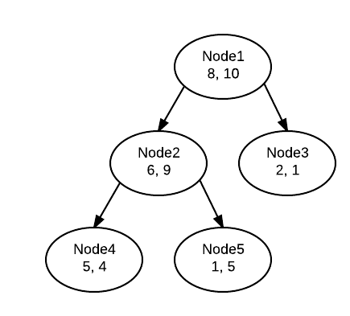
Pruning
Cloud Computing And Intelligent Information Processing Key Laboratory
CCP Example
Assume: The total amount of data in the decision tree is 40. follow figure is a sub-tree
Surface error ratio gain:
compare with other sub-tree surface error ratio gain

Slide 27
Outline
What is decision tree?
How to generate a decision tree?
CART & ID3 & C4.5
Pruning
Continuous and missing values
ID3 & Python

Slide 28
Continuous and missing values
Cloud Computing And Intelligent Information Processing Key Laboratory
Continuous And Missing Values
Continuous values:
Sort dataset sort(desc). then use bi-partition deal the continous values.
So, we can change Gini Index formual

Slide 29
Continuous and missing values
Cloud Computing And Intelligent Information Processing Key Laboratory
Continuous Values Example
Now we have a density dataset:
{0.244, 0.294, 0.351, 0.381, 0.420, 0.459,
0.518, 0.574, 0.600, 0.621, 0.636, 0.648,
0.661, 0.681, 0.708, 0.746}
According to T_{a}calculate formula, we can know the divide point is 0.381.

Slide 30
Continuous and missing values
Cloud Computing And Intelligent Information Processing Key Laboratory
Missing Values
Index | Color | Root | Stroke | Grain | Navel | Touch | Good?
1 | ? | Crouch | Voiced | Clear | Sunken | Hard | Yes
2 | Black | Crouch | Dull | Clear | Sunken | ? | Yes
3 | Black | Crouch | ? | Clear | Sunken | Hard | Yes
4 | Green | Crouch | Dull | Clear | Sunken | Hard | Yes
5 | ? | Crouch | Voiced | Clear | Sunken | Hard | Yes
6 | Green | little crouch | Voiced | Clear | ? | Soft | Yes
7 | Black | littel crouch | Voiced | little Vague | little Sunken | Soft | Yes
8 | Black | littel crouch | Voiced | ? | little Sunken | Hard | Yes
9 | Black | ? | Dull | little Vague | little Sunken | Hard | No
10 | Green | Stiff | Crisp | ? | flat | Soft | No
11 | White | Stiff | Crisp | Vague | flat | ? | No
12 | White | crouch | ? | Vague | flat | Soft | No
13 | ? | littel crouch | Voiced | little Vague | Sunken | Hard | No
14 | White | littel crouch | Dull | little Vague | Sunken | Hard | No
15 | Black | littel crouch | Voiced | Clear | ? | Soft | No
16 | White | crouch | Voiced | Vague | flat | Hard | No
17 | Green | ? | Dull | little Vague | little Sunken | Hard | No

Slide 31
Continuous and missing values
Cloud Computing And Intelligent Information Processing Key Laboratory
Two Problems
1. How to choice the divide attribute without some missing values.
2. Give a stable divide attribute, how to classifiy the missing value.

Slide 32
Continuous and missing values
Cloud Computing And Intelligent Information Processing Key Laboratory
Formulas
no missing value ratio
k-th class for no missing value samples ratio
the ratio of values (no missing samples
attribute a can get)

Slide 33
Continuous and missing values
Cloud Computing And Intelligent Information Processing Key Laboratory
Missing Values
Index | Color | Root | Stroke | Grain | Navel | Touch | Good?
1 | ? | Crouch | Voiced | Clear | Sunken | Hard | Yes
2 | Black | Crouch | Dull | Clear | Sunken | ? | Yes
3 | Black | Crouch | ? | Clear | Sunken | Hard | Yes
4 | Green | Crouch | Dull | Clear | Sunken | Hard | Yes
5 | ? | Crouch | Voiced | Clear | Sunken | Hard | Yes
6 | Green | little crouch | Voiced | Clear | ? | Soft | Yes
7 | Black | littel crouch | Voiced | little Vague | little Sunken | Soft | Yes
8 | Black | littel crouch | Voiced | ? | little Sunken | Hard | Yes
9 | Black | ? | Dull | little Vague | little Sunken | Hard | No
10 | Green | Stiff | Crisp | ? | flat | Soft | No
11 | White | Stiff | Crisp | Vague | flat | ? | No
12 | White | crouch | ? | Vague | flat | Soft | No
13 | ? | littel crouch | Voiced | little Vague | Sunken | Hard | No
14 | White | littel crouch | Dull | little Vague | Sunken | Hard | No
15 | Black | littel crouch | Voiced | Clear | ? | Soft | No
16 | White | crouch | Voiced | Vague | flat | Hard | No
17 | Green | ? | Dull | little Vague | little Sunken | Hard | No

Slide 34
Continuous and missing values
Cloud Computing And Intelligent Information Processing Key Laboratory
Missing Values Example
Choice color attribute:
{2, 3, 4, 6, 7, 8, 9, 10, 11, 12, 14, 15, 16, 17}

Slide 35
Outline
What is decision tree?
How to generate a decision tree?
CART & ID3 & C4.5
Pruning
Continuous and missing values
ID3 & Python

Slide 36
ID3 & Python
Cloud Computing And Intelligent Information Processing Key Laboratory
Pseudocode
ID3 (Examples, Target_Attribute, Attributes)
Create a root node for the tree
If all examples are positive, Return the single-node tree Root, with label = +.
If all examples are negative, Return the single-node tree Root, with label = -.
If number of predicting attributes is empty, then Return the single node tree Root,
with label = most common value of the target attribute in the examples.
Otherwise Begin
A ← The Attribute that best classifies examples.
Decision Tree attribute for Root = A.
For each possible value, v_{i}, of A,
Add a new tree branch below Root, corresponding to the test A = v_{i}.
Let Examples(v_{i}) be the subset of examples that have the value v_{i} for A
If Examples(v_{i}) is empty
Then below this new branch add a leaf node with label = most common target value in the examples
Else below this new branch add the subtree ID3 (Examples(v_{i}), Target_Attribute, Attributes – {A})
End
Return Root

Slide 37
ID3 & Python
Cloud Computing And Intelligent Information Processing Key Laboratory
Claculate Information Entroy
Source: Click Me

Slide 38
ID3 & Python
Cloud Computing And Intelligent Information Processing Key Laboratory
Calculate Information Gain
Source: Click Me

Slide 39
ID3 & Python
Cloud Computing And Intelligent Information Processing Key Laboratory
BuildTree
Source: Click Me

Slide 40
Cloud Computing And Intelligent Information Processing Key Laboratory
Thanks

